Slide 1

CAMPUS CONNECT
Campus Connect
Academic Tracking
A Centralized Student Collaboration
& Academic Management Platform
Community Hub
Event Management
Team Details
Professional Growth
Project Title: Campus Connect — Student Collaboration Platform
Team Member: Madhuri Mandala[2303A51295]
Department: Computer Science & Engineering
Institution: SR University
Year / Semester: 3rd Year / 6th Semester | 2025–26
Campus Connect · Project Evaluation Presentation · 2025–26

Slide 2



Introduction
What is Campus Connect?
Key Facts
› Full-stack web application (React + Node.js)
Campus Connect is a comprehensive, centralized web platform designed to bridge the gap between students, faculty, and administrators. It serves as a single digital hub that unifies academic management, community engagement, and professional growth — eliminating the need for scattered emails, spreadsheets, and separate portals.
› Role-Based Access Control (Student / Staff)
› JWT-secured authentication with bcrypt
› PostgreSQL database with Sequelize ORM
› Real-time frontend state management
❌ Fragmented campus tools
No unified student portal
✅ One platform for all needs
Students, Staff & Admins
▶
Academic Hub
Community
Opportunities
Subjects, tasks, grades, attendance — all in one place.
Forums, Team Finder, Events to collaborate beyond class.
Internships, jobs and research projects at your fingertips.
Campus Connect · Introduction

Slide 3






Objectives
What Campus Connect aims to achieve
1
Centralize Campus Operations
2
Implement Role-Based Access
Provide a single, unified platform replacing fragmented tools for academic and administrative tasks.
Ensure students, staff, and admins each see only the features and data relevant to their role via RBAC.
3
Enable Real-Time Academic Tracking
4
Foster Peer Collaboration
Allow instant visibility into grades, attendance records, and task completion without page reloads.
Build community features — forums, team finding, and event management — to connect students meaningfully.
5
Ensure Secure Authentication
6
Surface Professional Opportunities
Protect all user data using JWT tokens and bcrypt password hashing to prevent unauthorized access.
Aggregate internships, jobs, and research openings in one curated, always-accessible portal.
Campus Connect · Objectives

Slide 4




Stakeholders
Who uses Campus Connect — and what they gain
Students
Staff / Faculty
Administrators
Institution
› View & enroll in subjects
› Create & manage subjects and tasks
› Oversee all platform activity
› Digitize campus workflows
› Track tasks, grades & attendance
› Record daily attendance per subject
› Manage user roles & permissions
› Reduce dependency on scattered tools
› Join forums & find project teams
› Enter internal & external marks
› Monitor system-wide academic data
› Improve student engagement & outcomes
› Register for events & view opportunities
› Upload verified academic resources
› Publish opportunities and events
› Centralize data for reporting
› Manage profile and preferences
› Moderate forums & oversee enrollments
› Ensure data integrity & security
› Support accreditation documentation
Campus Connect · Stakeholders

Slide 5





Languages, Tools & Software
Frontend
Backend
Database
Dev Tools
AI Tools Used
React.js
Node.js
PostgreSQL
VS Code
ChatGPT (Logic & Prompts)
TypeScript
Express.js
Sequelize ORM
Postman (API Testing)
GitHub Copilot (Code)
Tailwind CSS
REST API
Relational Schema
GitHub (Version Control)
Claude (Code Review)
Lucide React Icons
JWT (Auth)
Migrations
pgAdmin
Cursor AI (Refactoring)
Vite (Build Tool)
bcrypt (Security)
Associations
npm / Node
v0.dev (UI Scaffolding)
Campus Connect · Technology Stack

Slide 6
AI Prompts Used to Generate Code
Actual prompts submitted to AI tools (ChatGPT / GitHub Copilot / Claude) during development:
P1
Authentication
"Create a Node.js Express authentication system with JWT tokens and bcrypt password hashing. Include register and login endpoints with role-based user model (student/staff) using Sequelize ORM and PostgreSQL."
P2
Attendance Module
"Build a full-stack attendance tracking module. Staff should be able to mark daily attendance per subject. Students should see their attendance percentage and history. Use React frontend with Axios and Express backend with PostgreSQL."
P3
Grades Portal
"Generate a grades management system where staff enter internal and external marks and grades are calculated automatically (A/B/C/D/F). Students can filter their grades by subject. Use Sequelize for DB operations."
P4
Team Finder Feature
"Implement a Team Finder page in React where students can post their skills and project ideas, and browse other students' profiles to form teams. Include a backend API with Express to save and retrieve team listings."
Campus Connect · AI Prompts Used

Slide 7
System Workflow Flowchart
START
User Visits Campus Connect
Registered?
Register Account
NO
YES
Login → JWT Token Generated
Student Dashboard
Role?
Staff Dashboard
Student
Staff
› Tasks & Grades
› CRUD Tasks/Events
› Attendance & Forum
END / Logout
› Attendance & Marks
Campus Connect · System Workflow

Slide 8
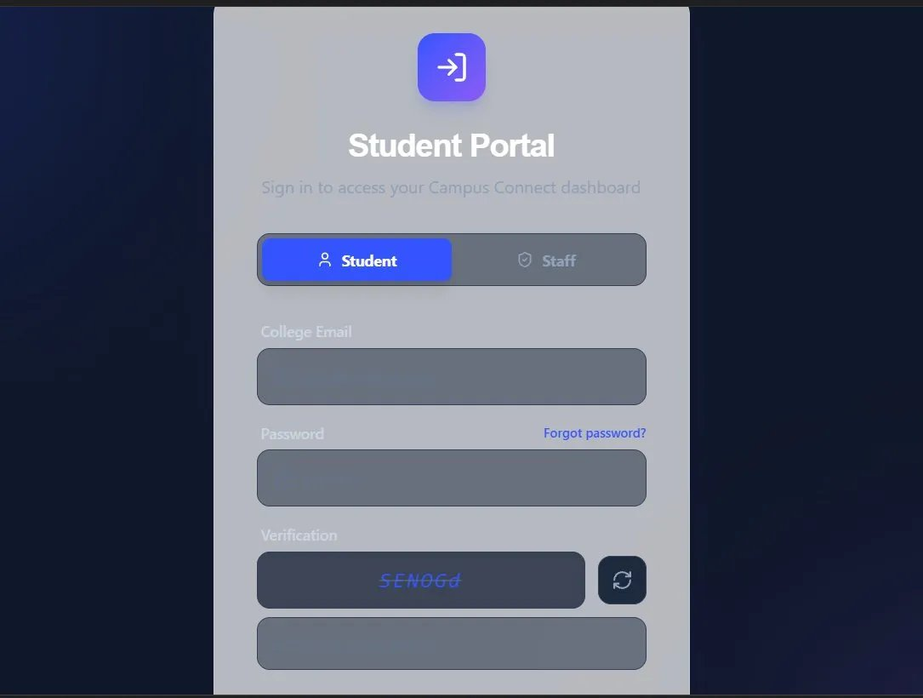
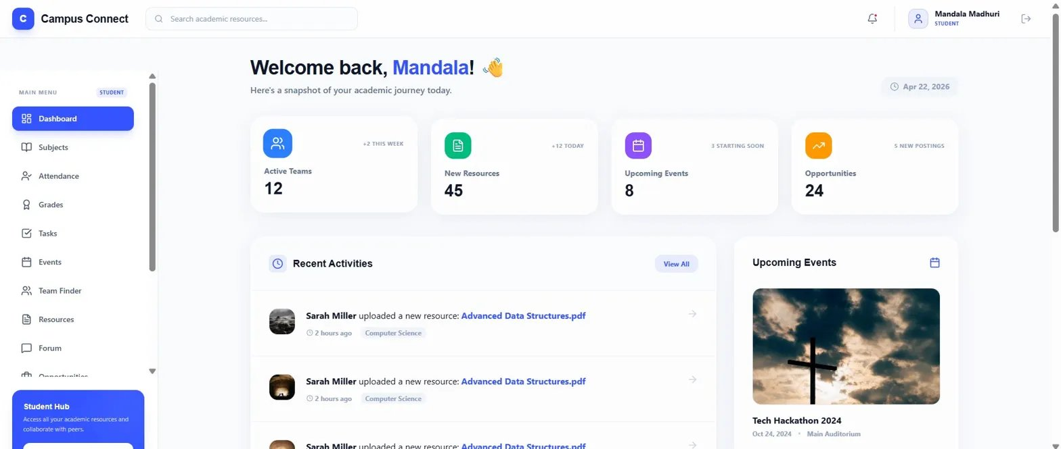
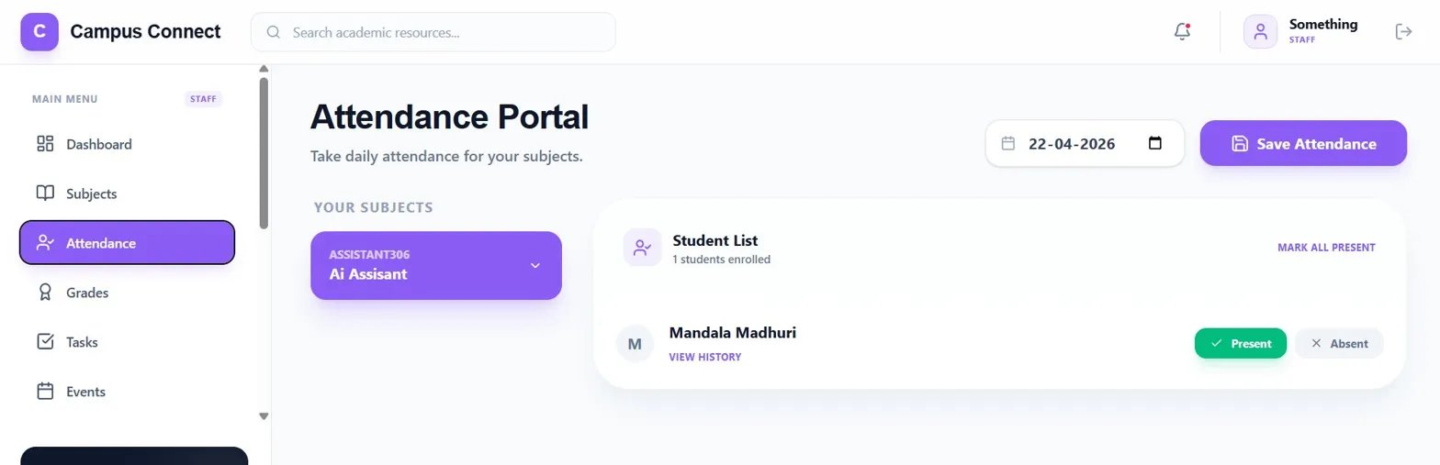
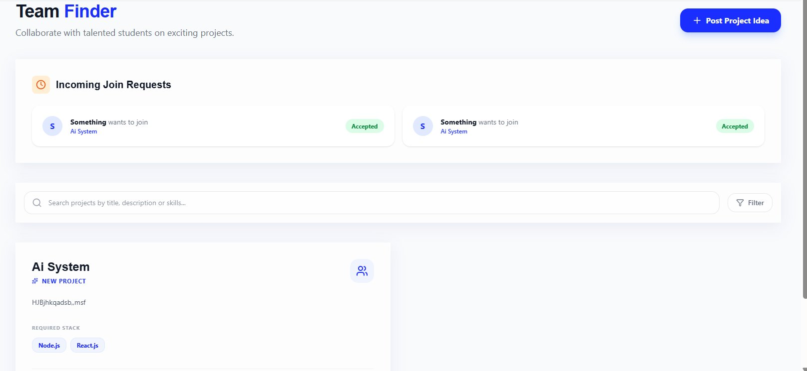
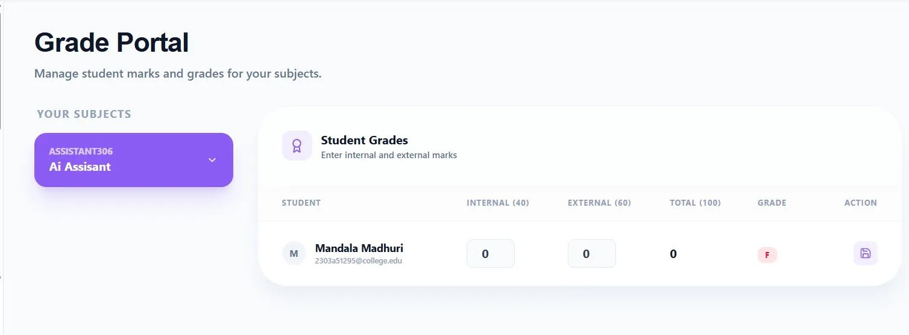
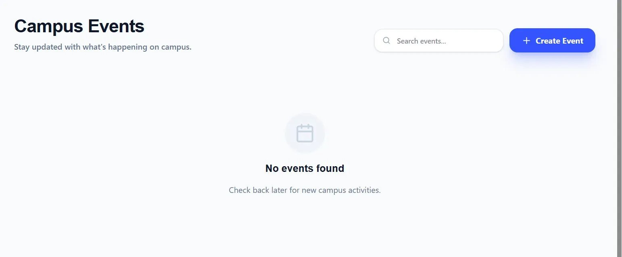
Front-End View of Web Application
Key screens from the Campus Connect web application
localhost:3000
localhost:3000
localhost:3000
Login Page
Student Dashboard
Attendance Portal
JWT-secured login
with role detection
Personalized feed
Tasks & Grades view
Staff marks daily
Students view history
localhost:3000
localhost:3000
localhost:3000
Team Finder
Grade Portal
Events Calendar
Browse & post
project partner ads
Auto-calculated
grades per subject
One-click register
for workshops
Campus Connect · UI Screens

Slide 9
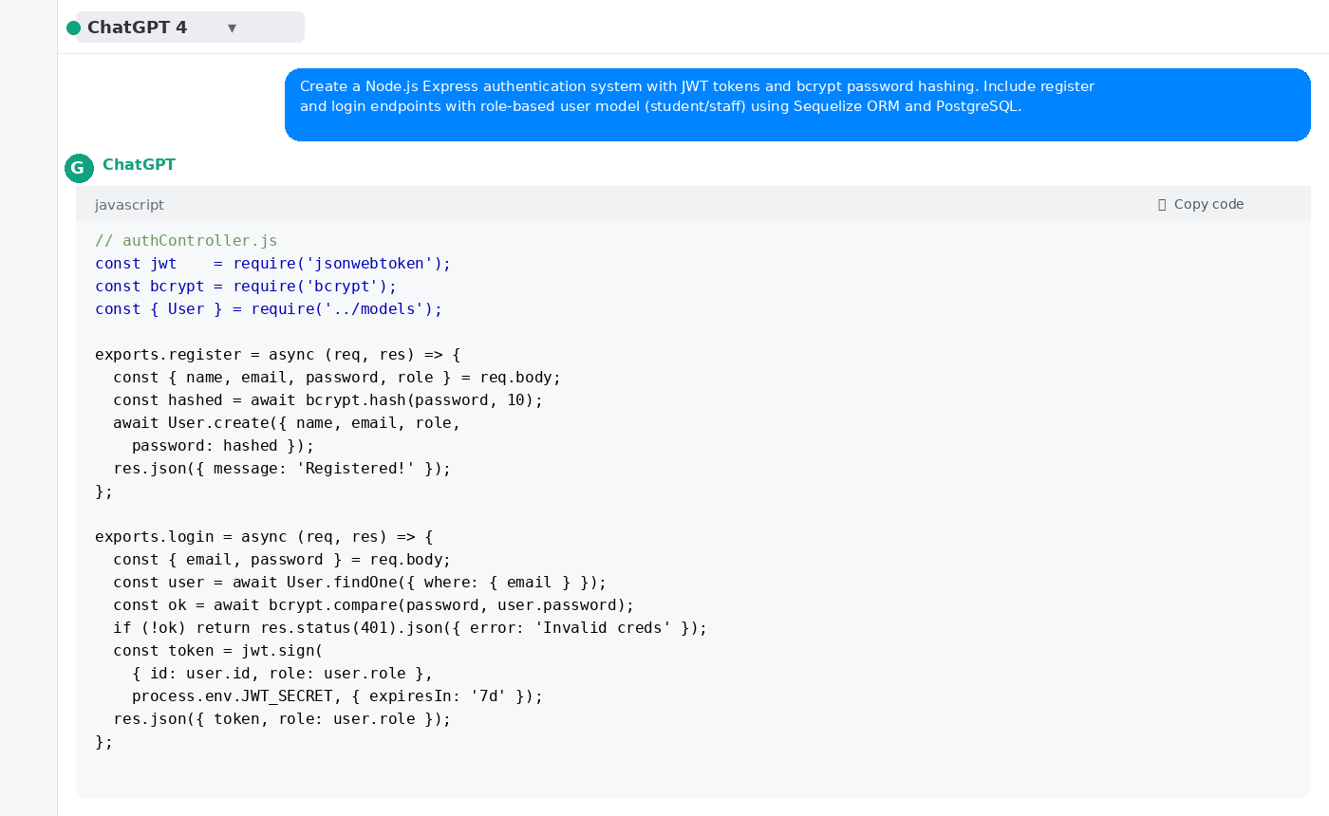
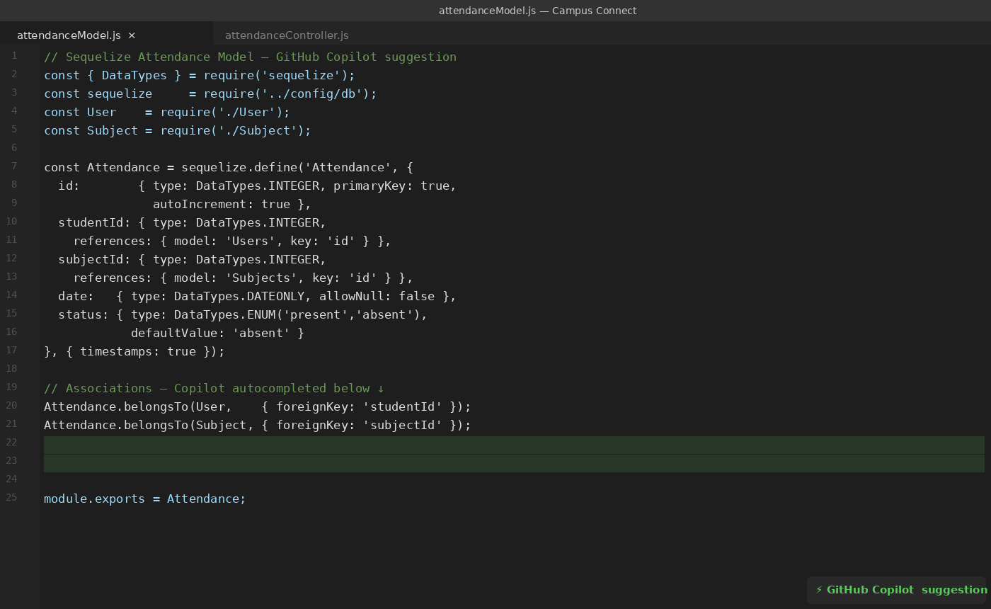
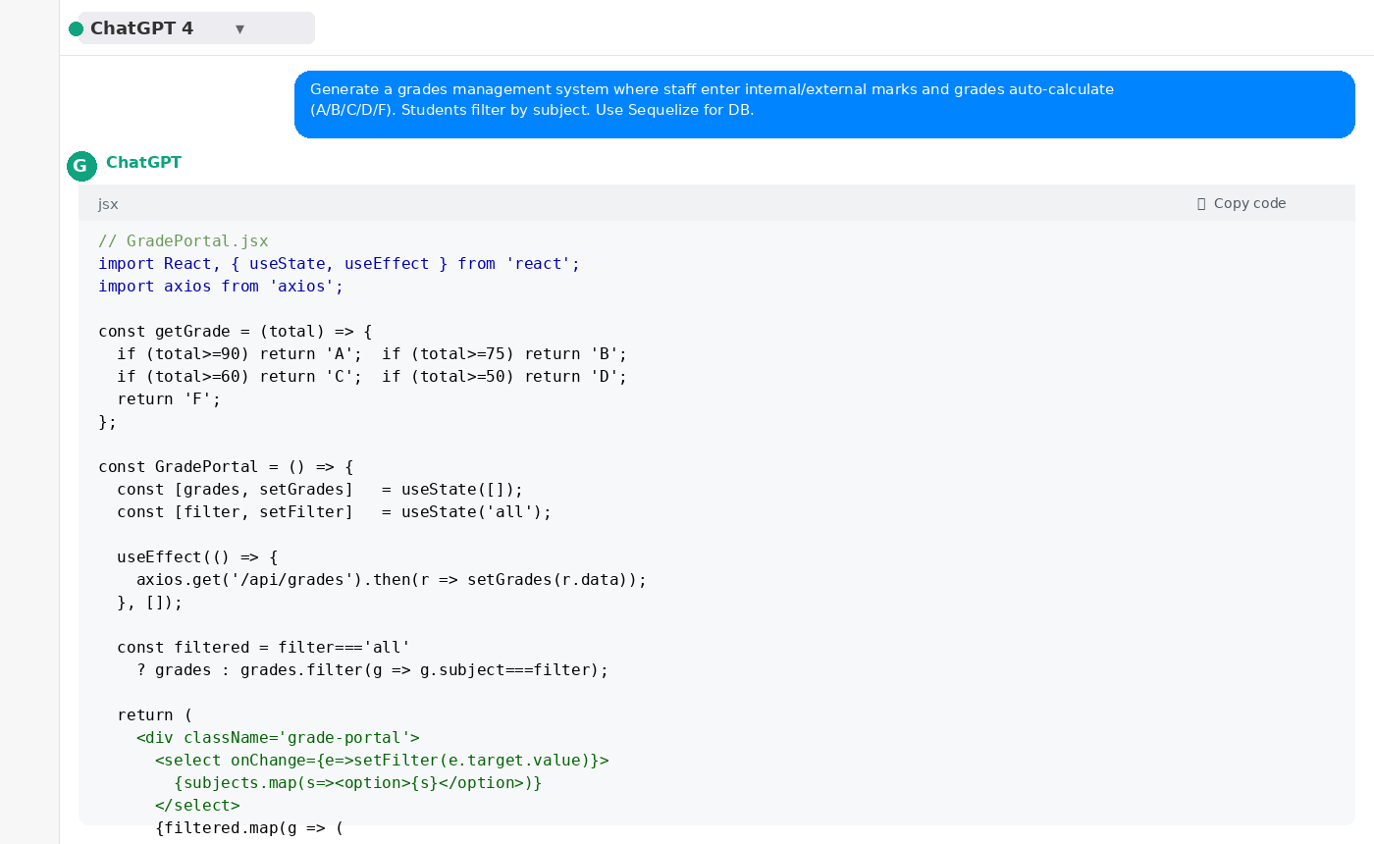
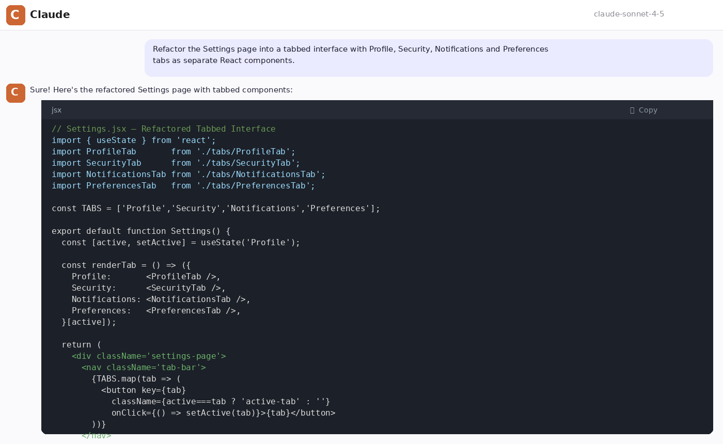
Proof of Prompts Generating Code
Screenshots showing AI tools generating actual project code
01
🔧 ChatGPT
02
🔧 GitHub Copilot
Generating JWT auth middleware
(register/login endpoints with bcrypt)
Auto-completing Sequelize model
(Attendance table with associations)
03
🔧 ChatGPT
04
🔧 Claude AI
Producing React component
(Grade portal with filter by subject)
Refactoring Settings page
into tabbed interface components
Campus Connect · AI-Generated Code Proof

Slide 10
References
Documentation, Libraries, AI Tools & Learning Resources used in this project
Official Docs
Libraries & Tools
AI Tools
[1] React Documentation — https://react.dev
[6] Tailwind CSS — https://tailwindcss.com/docs
[11] OpenAI ChatGPT — https://chatgpt.com
[2] Node.js Documentation — https://nodejs.org/docs
[7] JSON Web Tokens — https://jwt.io
[12] GitHub Copilot — https://github.com/features/copilot
[3] Express.js Guide — https://expressjs.com/en/guide
[8] bcrypt npm Package — https://www.npmjs.com/package/bcrypt
[13] Anthropic Claude — https://claude.ai
[4] Sequelize ORM Docs — https://sequelize.org/docs
[9] Lucide React Icons — https://lucide.dev
[14] Cursor AI — https://cursor.sh
[5] PostgreSQL Documentation — https://www.postgresql.org/docs
[10] Postman API Tool — https://www.postman.com
[15] Vercel v0.dev — https://v0.dev
Campus Connect · Student Collaboration Platform · Presented for Project Evaluation · 2025–26

